Slide 1
Topic 6A Ubuntu Linux Installation

Slide 2
Contents
Linux Distributions
Using VMware & KVM
Installing UBUNTU Linux
Other methods of installation

Slide 3
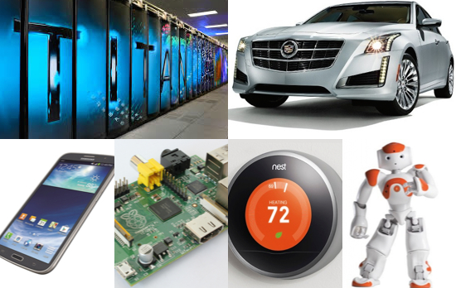
Linux Operating System
Notes:
From smartphones to cars, supercomputers and home appliances, the Linux operating system is everywhere.
Linux. It’s been around since the mid ‘90s, and has since reached a user-base that spans industries and continents. For those in the know, you understand that Linux is actually everywhere. It’s in your phones, in your cars, in your refrigerators, your Roku devices. It runs most of the Internet, the supercomputers making scientific breakthroughs, and the world\'s stock exchanges. But before Linux became the platform to run desktops, servers, and embedded systems across the globe, it was (and still is) one of the most reliable, secure, and worry-free operating systems available.

Slide 4
What is Linux OS?
Just like Windows XP, Windows 7, Windows 8, and Mac OS X, Linux is an operating system. An operating system is software that manages all of the hardware resources associated with your desktop or laptop. To put it simply – the operating system manages the communication between your software and your hardware. Without the operating system (often referred to as the “OS”), the software wouldn’t function. https://www.linux.com/what-is-linux

Slide 5
The OS is comprised of a number of pieces:
The Bootloader: The software that manages the boot process of your computer. For most users, this will simply be a splash screen that pops up and eventually goes away to boot into the operating system.
The kernel: This is the one piece of the whole that is actually called “Linux”. The kernel is the core of the system and manages the CPU, memory, and peripheral devices. The kernel is the “lowest” level of the OS.

Slide 6
Daemons: These are background services (printing, sound, scheduling, etc) that either start up during boot, or after you log into the desktop.
The Shell: You’ve probably heard mention of the Linux command line. This is the shell – a command process that allows you to control the computer via commands typed into a text interface. This is what, at one time, scared people away from Linux the most (assuming they had to learn a seemingly archaic command line structure to make Linux work).

Slide 7
Graphical Server: This is the sub-system that displays the graphics on your monitor. It is commonly referred to as the X server or just “X”.
Desktop Environment: This is the piece of the puzzle that the users actually interact with. There are many desktop environments to choose from (Unity, GNOME, Cinnamon, Enlightenment, KDE, XFCE, etc). Each desktop environment includes built-in applications (such as file managers, configuration tools, web browsers, games, etc).

Slide 8
Applications: Desktop environments do not offer the full array of apps. Just like Windows and Mac, Linux offers thousands upon thousands of high-quality software titles that can be easily found and installed.

Slide 9
Most modern Linux distributions (more on this in a moment) include App Store-like tools that centralize and simplify application installation. For example: Ubuntu Linux has the Ubuntu Software Center which allows you to quickly search among the thousands of apps and install them from one centralized location.
https://help.ubuntu.com/community/UbuntuSoftwareCenter

Slide 10
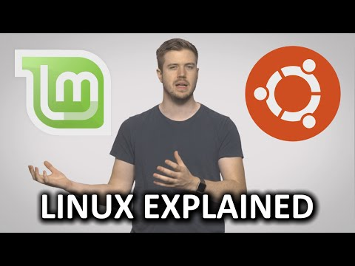
What is LINUX?

Slide 11
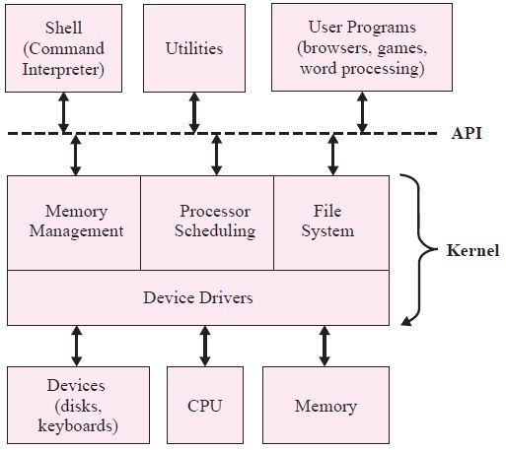
Layered Architecture
Functions divided into layers
Each layer higher abstraction
New device drivers could be added to the kernel without drastically affecting the other OS modules, which provide memory management, processor scheduling, and the file system interface.

Slide 12
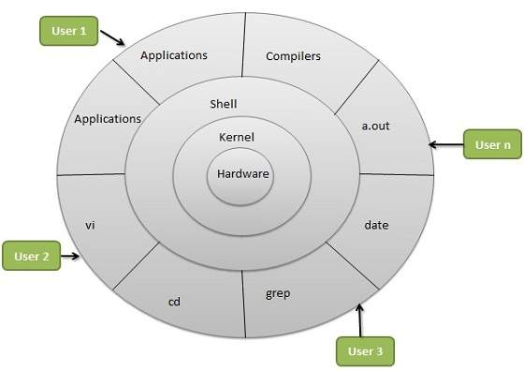
Linux Architecture
The architecture of a Linux System consists of the following layers −
Hardware layer − Hardware consists of all peripheral devices (RAM/ HDD/ CPU etc).
Kernel − It is the core component of Operating System, interacts directly with hardware, provides low level services to upper layer components.
Shell − An interface to kernel, hiding complexity of kernel's functions from users. The shell takes commands from the user and executes kernel's functions.
Utilities − Utility programs that provide the user most of the functionalities of an operating systems.

Slide 13
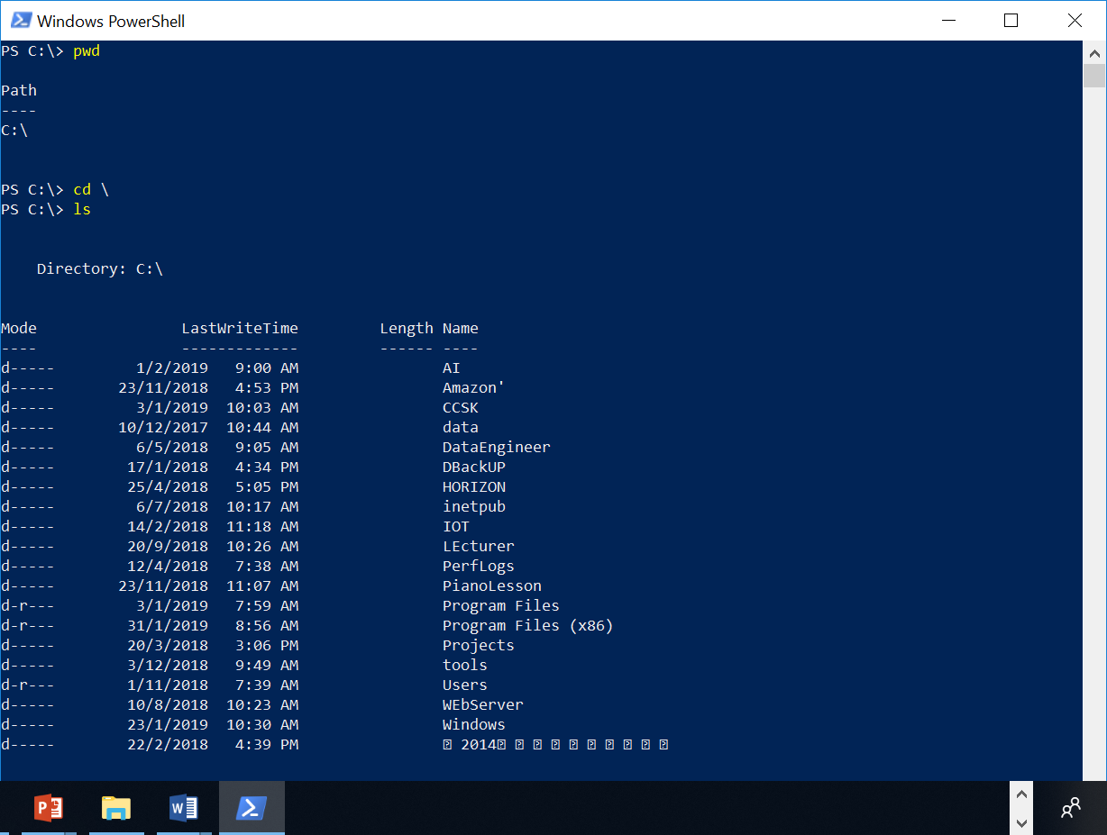
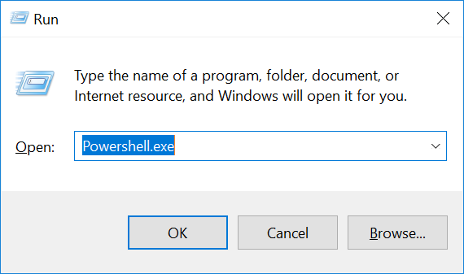
Windows PowerShell

Slide 14
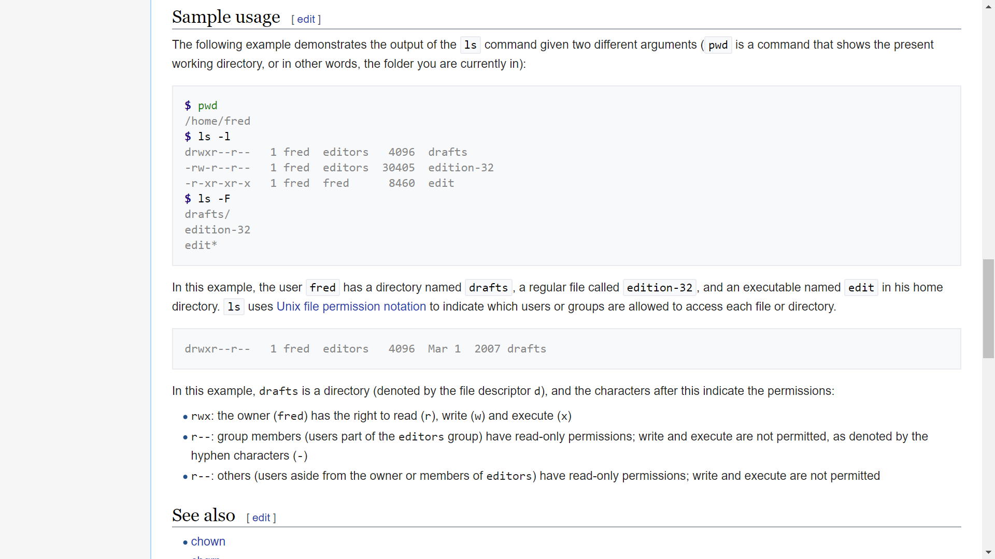
Linux Shell
Notes:
https://en.wikipedia.org/wiki/Ls

Slide 15
Linux Distributions
Linux comes in different variations, called distributions
Red Hat Enterprise Linux (RHEL) – commercial support by subscription
Fedora (Red Hat sponsored and community-based open source)
Ubuntu
Scientific Linux
CentOS
…

Slide 16
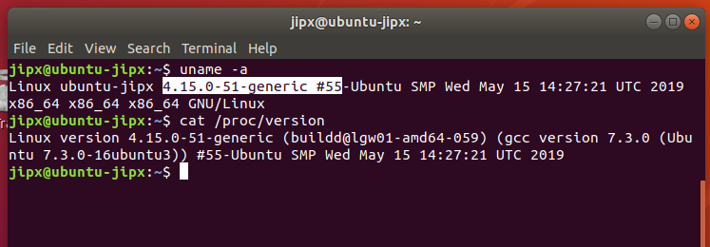
Demo: find the kernel info
Kernel Name | hostname | Kernel release | Machine Architecture | Processor architecture | Operating system Architecture
Linux | ubuntu-jipx | 4.15.0-51-generic #55-Ubuntu | x86_64 | x86_64 | x86_64

Slide 17
Using VMware
As our computers are installed with Windows operating system, we will run Linux in VMware
VMware can run multiple operating systems on a single physical computer

Slide 18
Using VMware
The virtual network adapter on the VM (Virtual machine) can be configured with different settings
Bridged – VM appears as a separate system on the physical network
NAT – VM is hidden behind the host. VM can see the network but the rest of the network can not see the VM.
Host only – VM is hidden behind the host. VM can not access the network beyond the host and the rest of the network can not see the VM

Slide 19
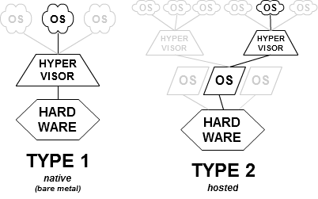
KVM
A hypervisor or virtual machine monitor (VMM) is a piece of computer software, firmware or hardware that creates and runs virtual machines.
A computer on which a hypervisor is running one or more virtual machines is defined as a host machine. Each virtual machine is called a guest machine. The hypervisor presents the guest operating systems with a virtual operating platform and manages the execution of the guest operating systems. Multiple instances of a variety of operating systems may share the virtualized hardware resources.
Kernel-based Virtual Machine (KVM) are implemented as Type 2 (hosted), with the hypervisor as a kernel module for Linux.

Slide 20
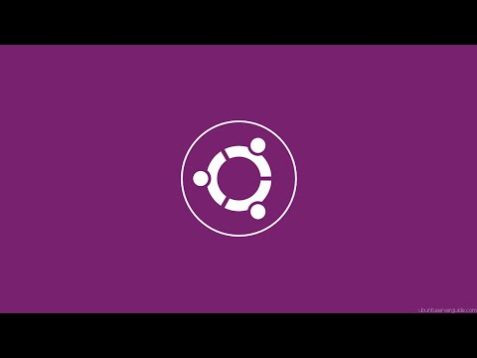
Practical : Installing Ubuntu Linux on your VMware Workstation

